Slide 1
John 12.20-36
Photo from foodsafetynews.com

Slide 2
John 12.20-22 NET: Now some Greeks were among those who had gone up to worship at the feast. So these approached Philip, who was from Bethsaida in Galilee, and requested, “Sir, we would like to see Jesus.” Philip went and told Andrew, and they both went and told Jesus.

Slide 3
John 12.23-24: Jesus replied, “The time has come for the Son of Man to be glorified. I tell you the solemn truth, unless a kernel of wheat falls into the ground and dies, it remains by itself alone. But if it dies, it produces much grain.”
a prophetic title which Jesus used about himself

Slide 4
John 12.23-24: Jesus replied, “The time has come for the Son of Man to be glorified.
I tell you the solemn truth, unless a kernel
of wheat falls into the ground and dies, it
remains by itself alone. But if it dies, it
produces much grain.”
Isaiah 52.13

Slide 5
John 12.23-24: Jesus replied, “The time has come for the Son of Man to be glorified. I tell you the solemn truth, unless a kernel of wheat falls into the ground and dies, it remains by itself alone. But if it dies, it
produces much grain.”

Slide 6
John 12.25-26: “The one who loves his life destroys it, and the one who hates his life in this world guards it for eternal life. If anyone wants to serve me, he must follow me, and where I am, my servant will be too. If anyone serves me, the Father will honor him.”

Slide 7
John 12.25-26: “The one who loves his life destroys it, and the one who hates his life in this world guards it for eternal life. If anyone wants to serve me, he must follow me, and where I am, my servant will be too. If anyone serves me, the Father will honor him.”
hate life = be willing to die to selfish desires and live for Christ and his gospel mission
love life = live for now instead of eternity, for worldly ambitions instead of biblical and godly ones, for flesh instead of for God

Slide 8
John 12.25-26: “The one who loves his life destroys it, and the one who hates his life in this world guards it for eternal life. If anyone wants to serve me, he must follow me, and where I am, my servant will be too. If anyone serves me, the Father will honor him.”

Slide 9
John 12.27-28: “Now my soul is greatly distressed. And what should I say? ‘Father, deliver me from this hour’? No, but for this very reason I have come to this hour. Father, glorify your name.” Then a voice came from heaven, “I have glorified it, and I will glorify it again.”

Slide 10
John 12.29-32: The crowd that stood there and heard the voice said that it had thundered. Others said that an angel had spoken to him. Jesus said, “This voice has not come for my benefit but for yours. Now is the judgment of this world; now the ruler of this world will be driven out. And I, when I am lifted up from the earth, will draw all people to myself.”

Slide 11
John 12.29-32: The crowd that stood there and heard the voice said that it had thundered. Others said that an angel had spoken to him. Jesus said, “This voice has not come for my benefit but for yours. Now is the judgment of this world; now the ruler of this world will be driven out. And I, when I am lifted up from the earth, will draw all people to myself.”

Slide 12
John 12.29-32: The crowd that stood there and heard the voice said that it had thundered. Others said that an angel had spoken to him. Jesus said, “This voice has not come for my benefit but for yours. Now is the judgment of this world; now the ruler of this world will be driven out. And I, when I am lifted up from the earth, will draw all people to myself.”

Slide 13
John 12.33-34: (Now he said this to indicate clearly what kind of death he was going to die.) Then the crowd responded, “We have heard from the law that the Christ will remain forever. How can you say, ‘The Son of Man must be lifted up’? Who is this Son of Man?”

Slide 14
John 12.35-36: Jesus replied, “The light is with you for a little while longer. Walk while you have the light, so that the darkness may not overtake you. The one who walks in the darkness does not know where he is going. While you have the light, believe in the light, so that you may become sons of light.” When Jesus had said these things, he went away and hid himself from them.

Slide 15
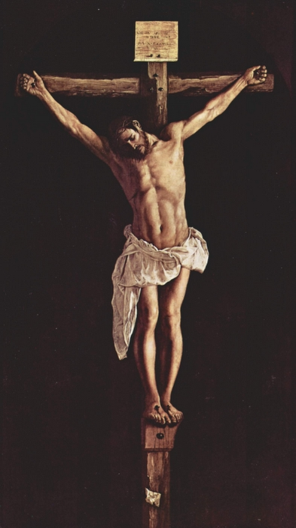
Francisco de Zurbaran Vanderbilt.edu

